Slide 1
Python! Day 10
Opening a new file for our next Python project
Coffee machine program
Python! Day 10

Slide 2
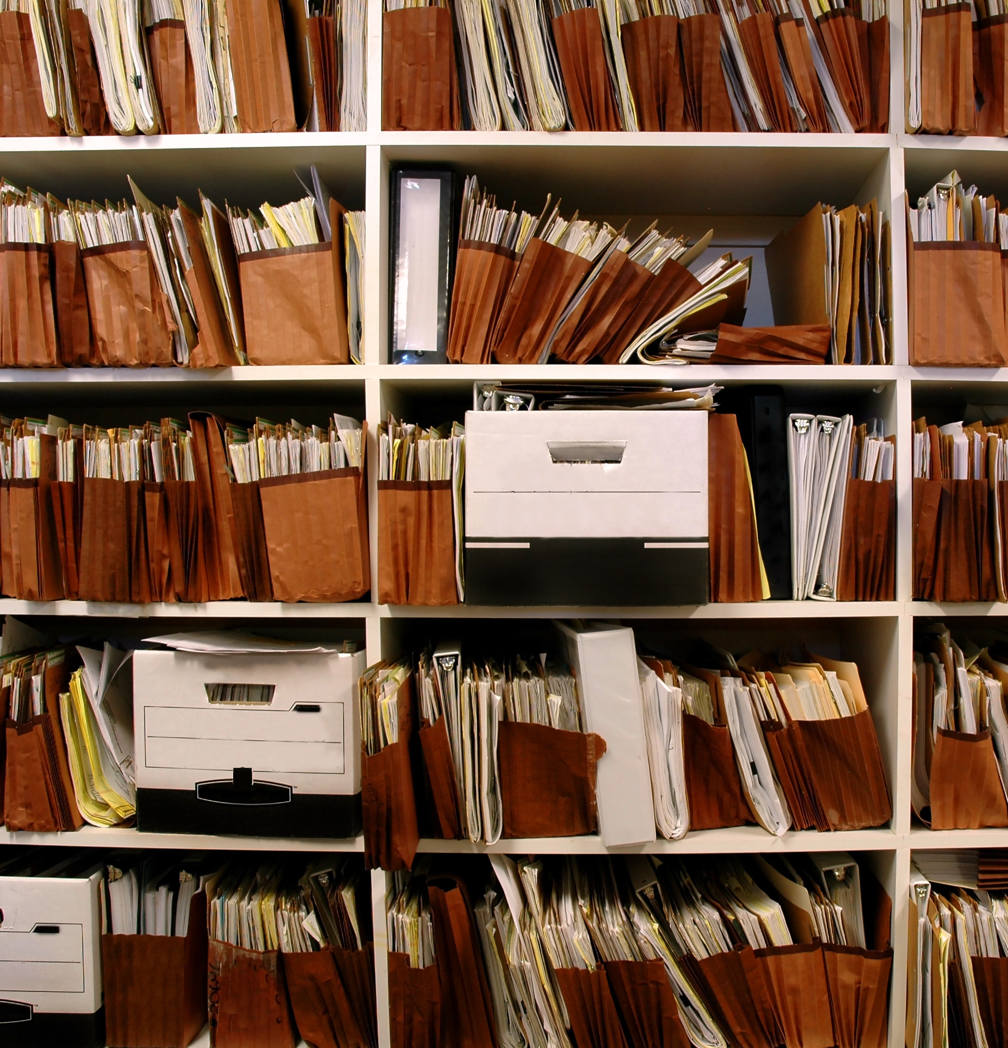
Opening a new file
So far, we’ve been doing all our coding on the same python file
But when creating more complicated programs, programmers like to create new folders and files specific to the project
Today, we’ll be creating a complicated coffee machine project, so we should create a new file for it
Somewhere on your computer, create a new folder called “CoffeeMachineProject.”
Next, we can open a new Python file by pressing New Project and selecting our new folder as the location
Finally, press Create

Slide 3
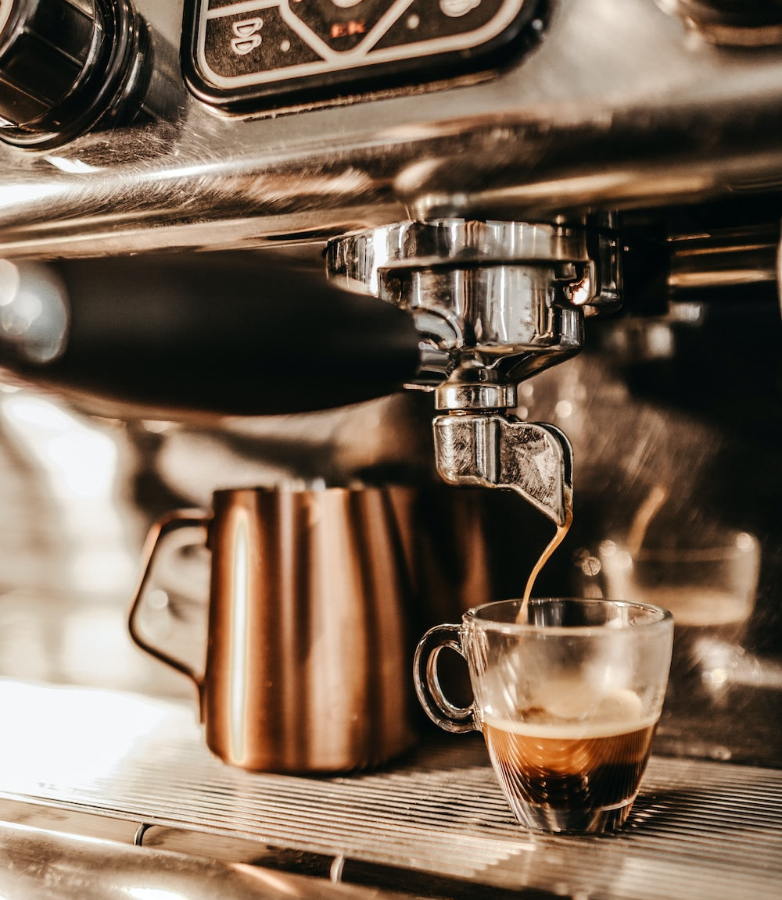
Coffee Machine Project
Today, we’ll create a program that functions like a coffee machine
It will have a certain amount of water, milk, and coffee that will deplete when the user orders coffee
The user will have to pay for their coffee in coins, and the program will give back any extra change
If the user doesn’t have enough coins or the program doesn’t have enough ingredients, the program will say, “Sorry we can’t make the drink,” and will refund all the money
The three drinks that can be ordered are a cappuccino, a latte, and an espresso

Slide 4
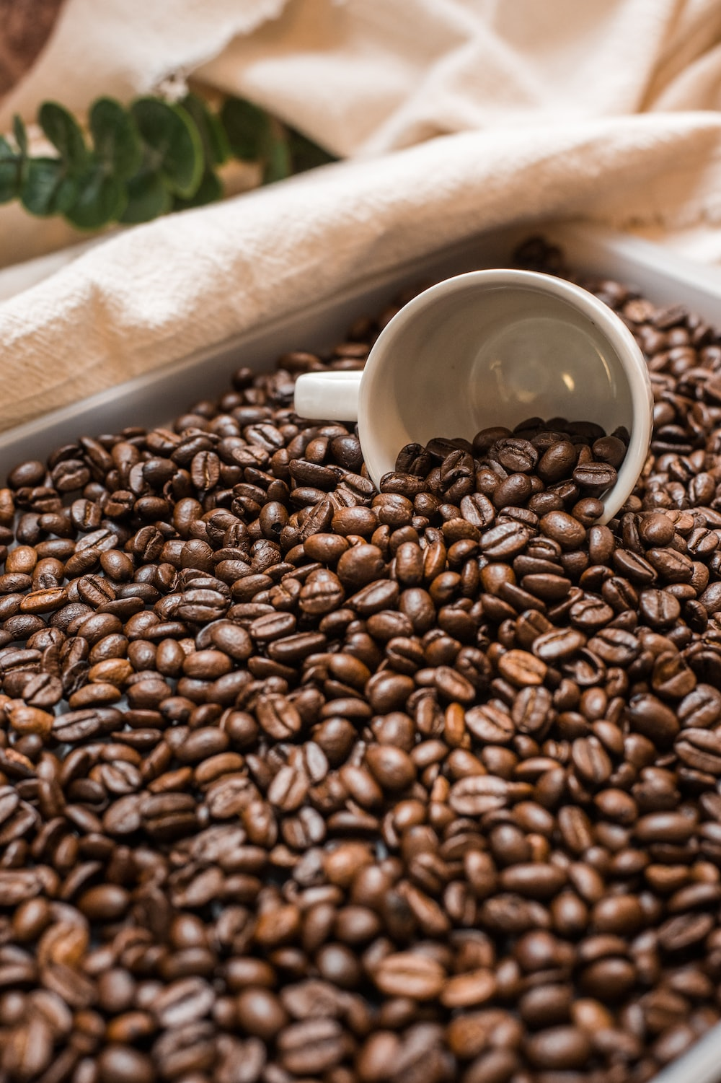
First: Creating Dictionaries
We’ll start the program by creating dictionaries that hold information on what each drink requires to make and how much each drink costs
We’ll also create a dictionary to track how much resources the coffee machine has
Starting resources: 300 mL water, 200 mL milk, and 100 g coffee
Cappuccino requirements: 250 mL water, 100 mL milk, 24 g coffee, and cost = $3.00
Latte requirements: 200 mL water, 150 mL milk, 24 g coffee, and cost = $2.50
Espresso requirements: 50 mL water, 0 mL milk, 10 g coffee, and cost = $1.50

Slide 5
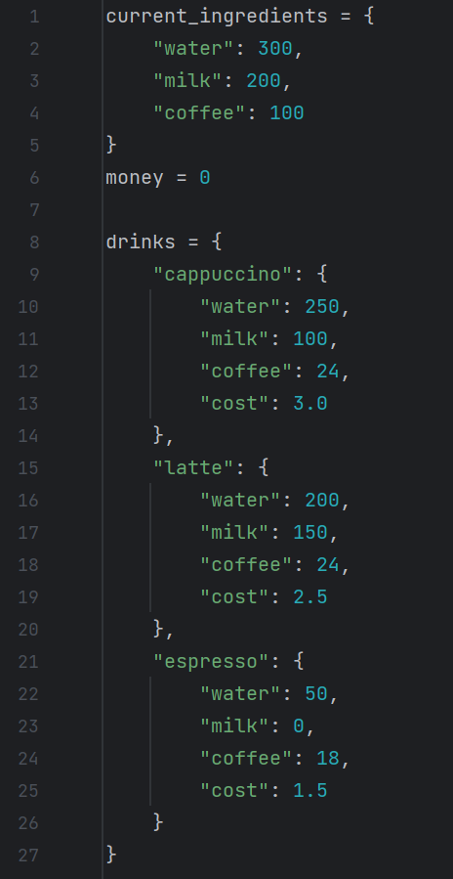
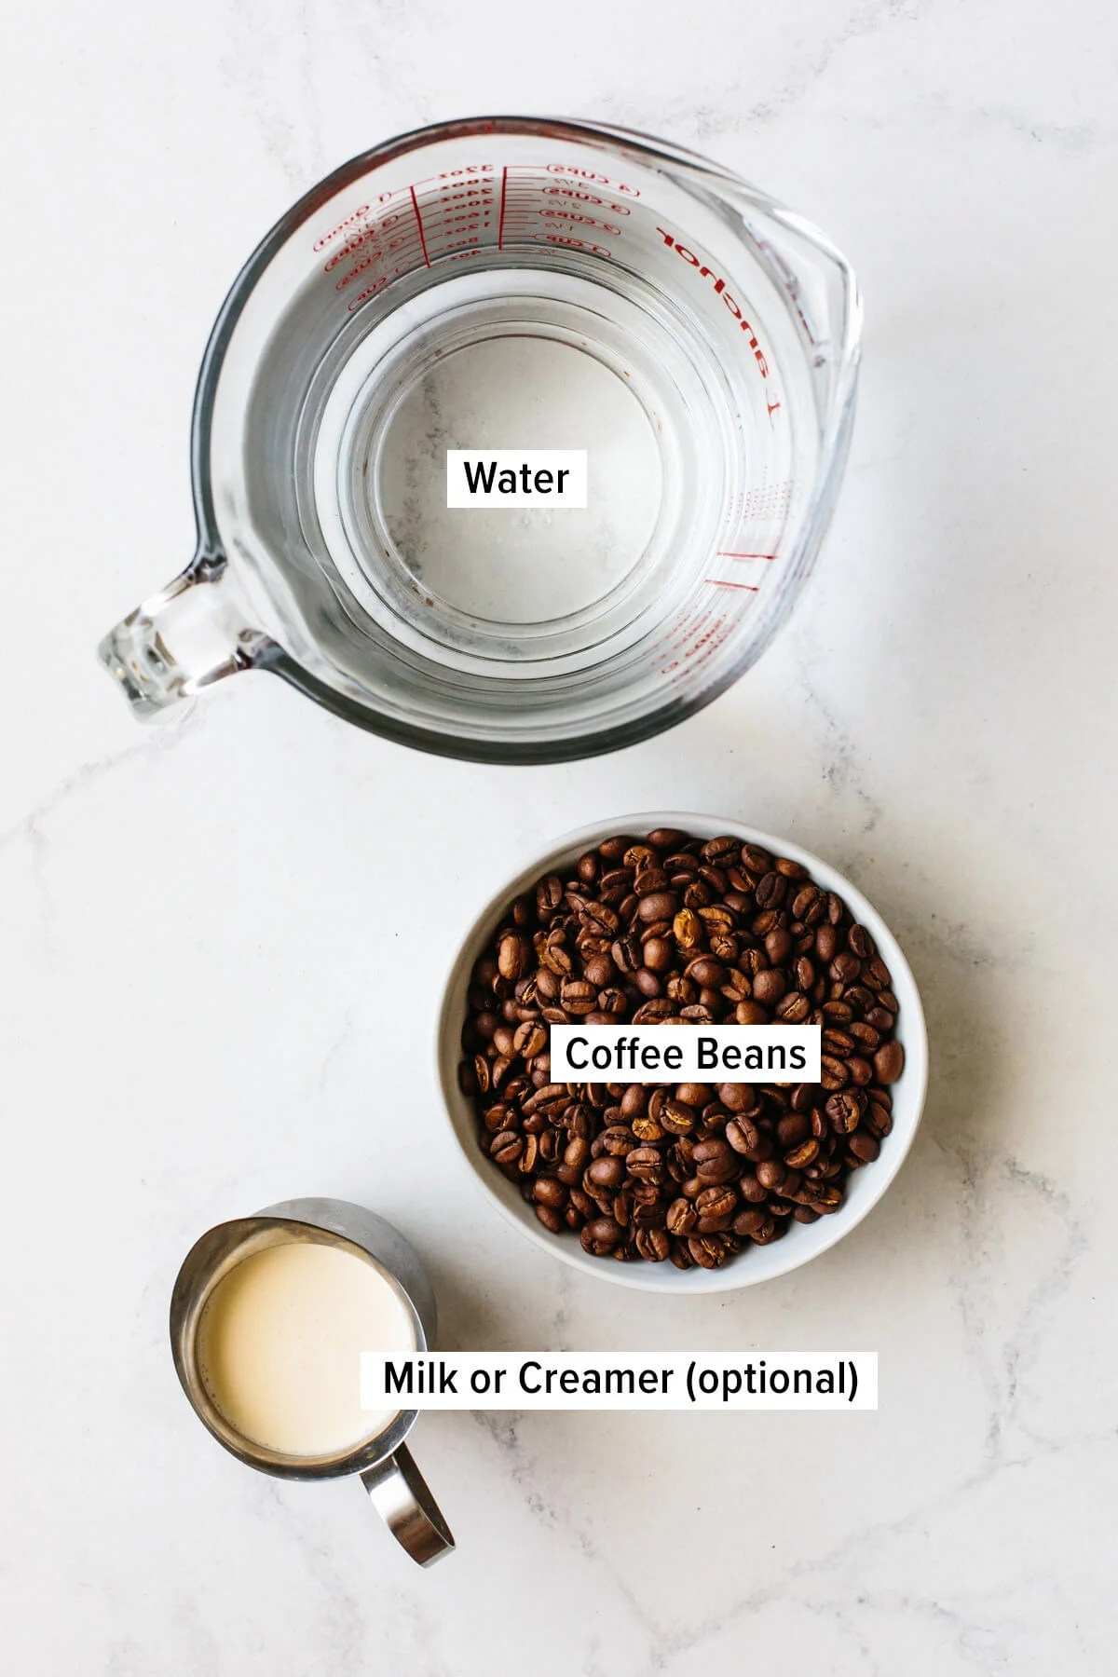
To do this, we’ll have to create a dictionary inside a dictionary
This way, we can keep track of more than one related variable at a time
We can also create a variable to keep track of how much money the machine has collected

Slide 6
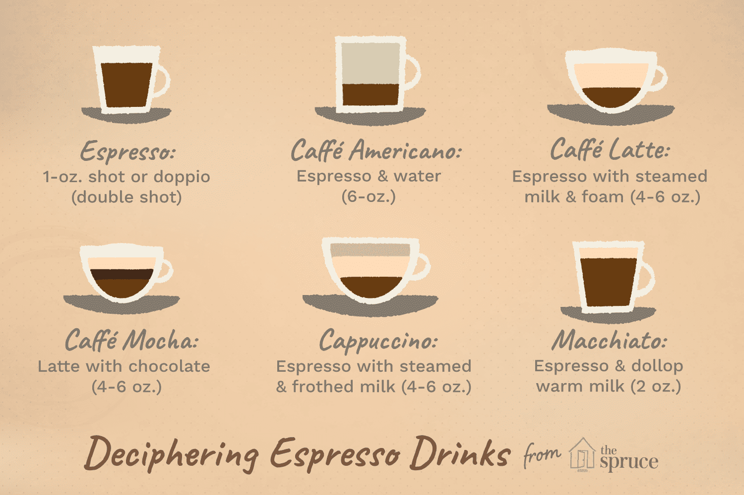
Second: Getting the user’s order
Next, we’ll want to write print statements that introduce the program to the user and ask them what they want to order
However, we want to be able to order a cup of coffee over and over, so let’s put the statement where we get the user’s order into a while loop
We’ll also have to create a variable that keeps track of if the user wants to order another coffee, and we’ll ask them at the end of the while loop if they will order another drink

Slide 7
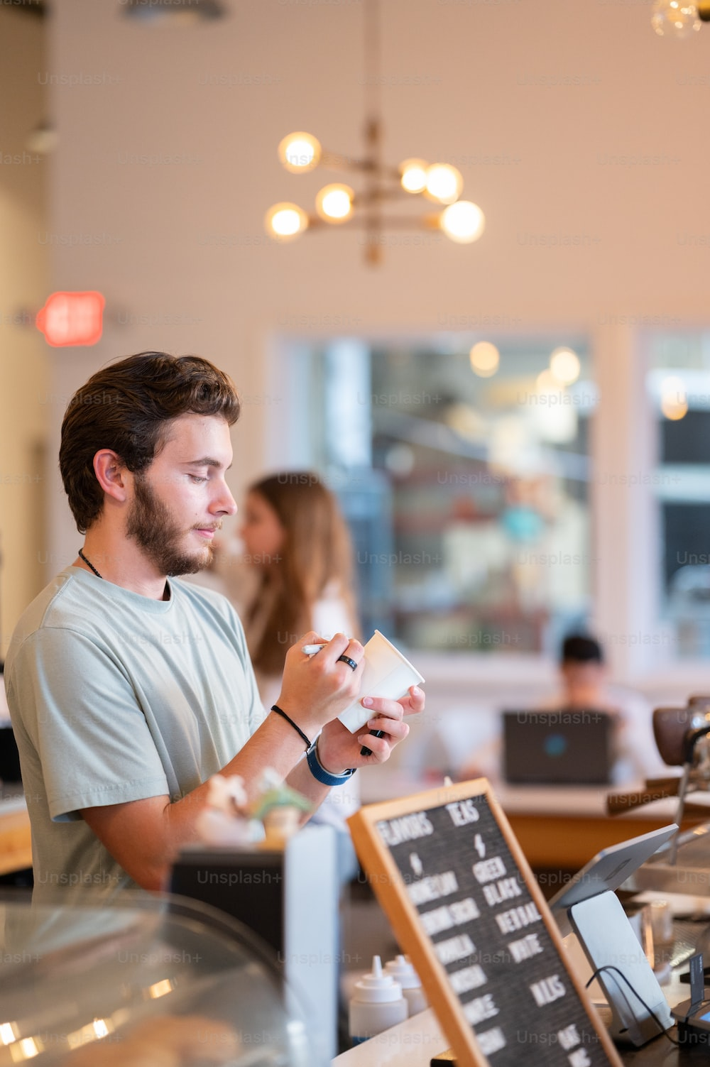
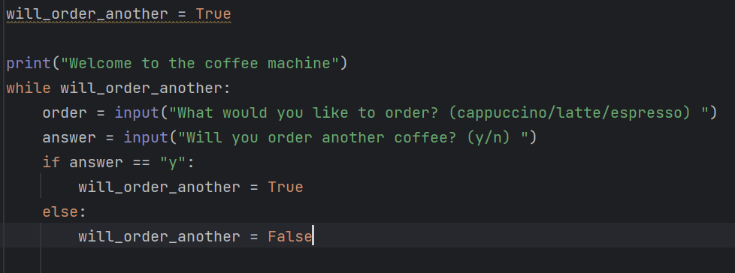

Slide 8
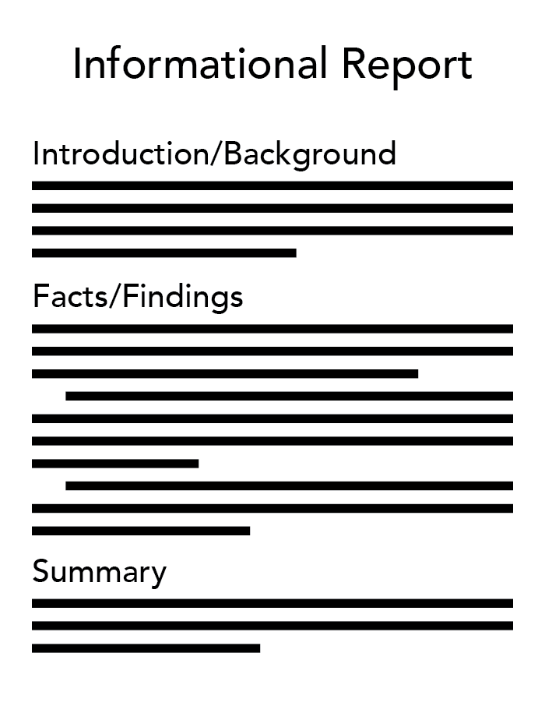
Third: Reporting the machine’s resources
When the user orders a “report,” the program must print what the coffee machine’s current resources are
To do this, we can write an if statement that calls a function called get_report() whenever the user’s order is “report”
This get_report() function will print the machine’s resources using the current resources dictionary
When printing the money in the machine, we can use the round(number, num_decimal_places) function to round the number
This Photo by Unknown Author is licensed under CC BY

Slide 9
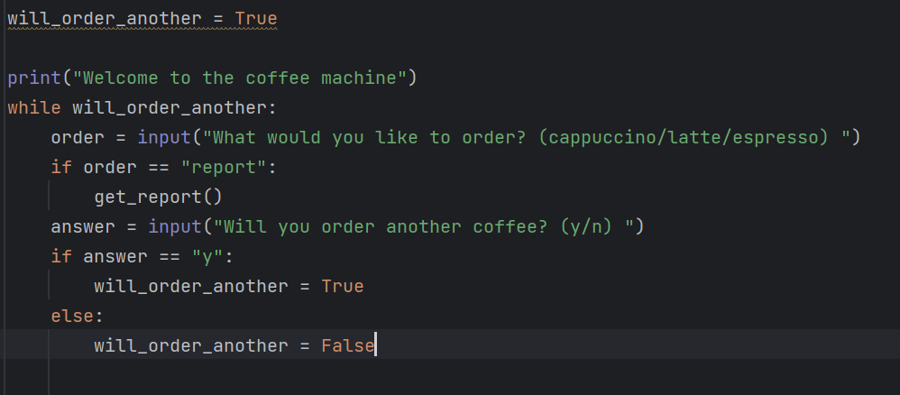
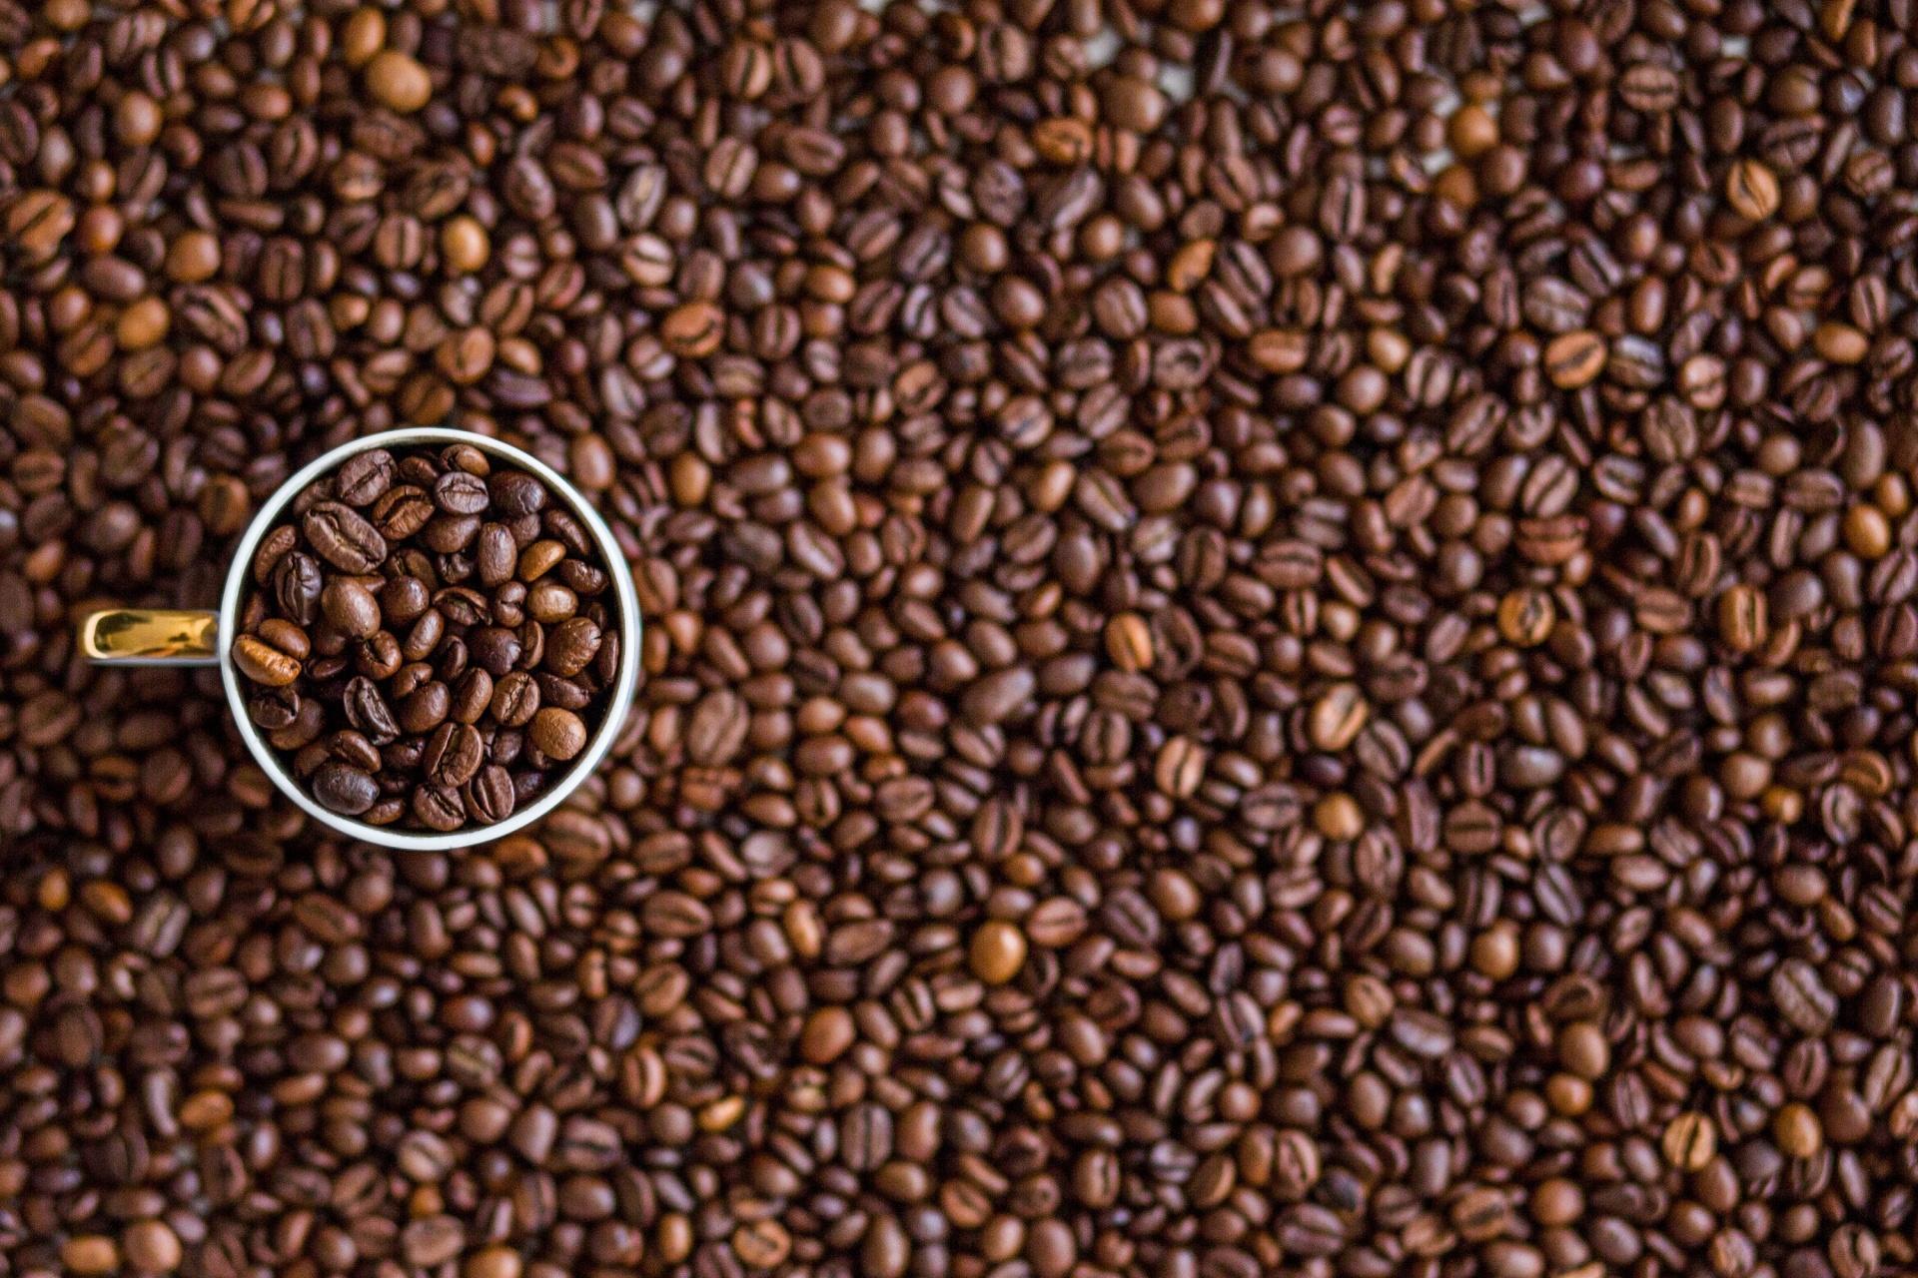
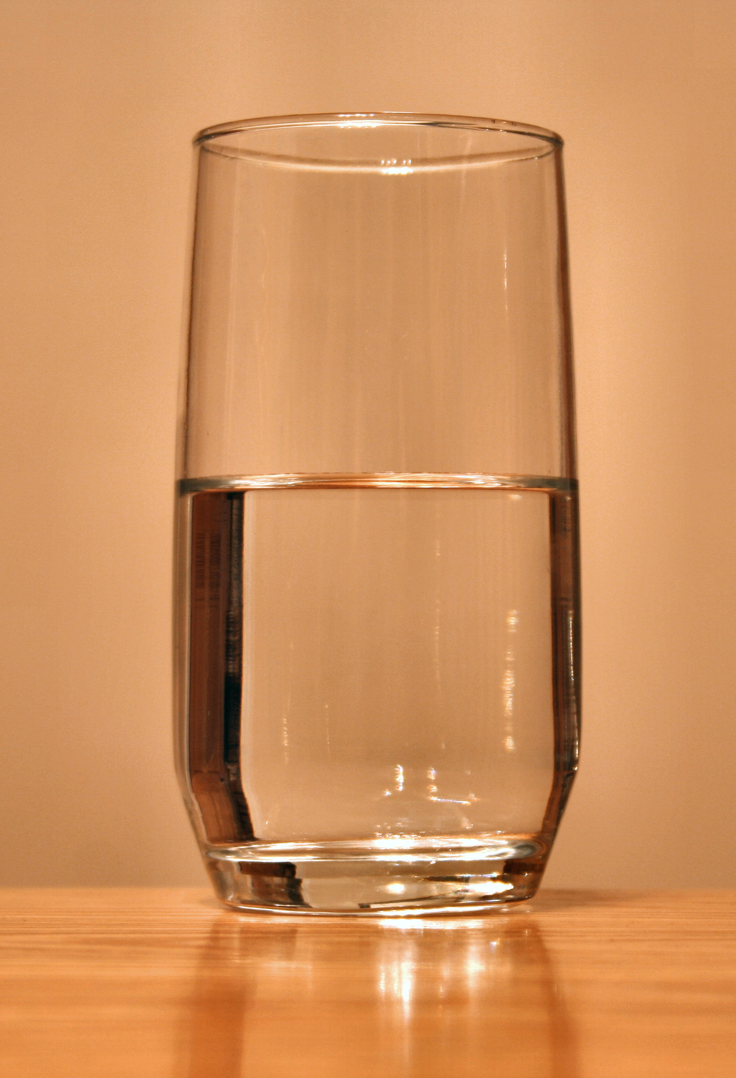
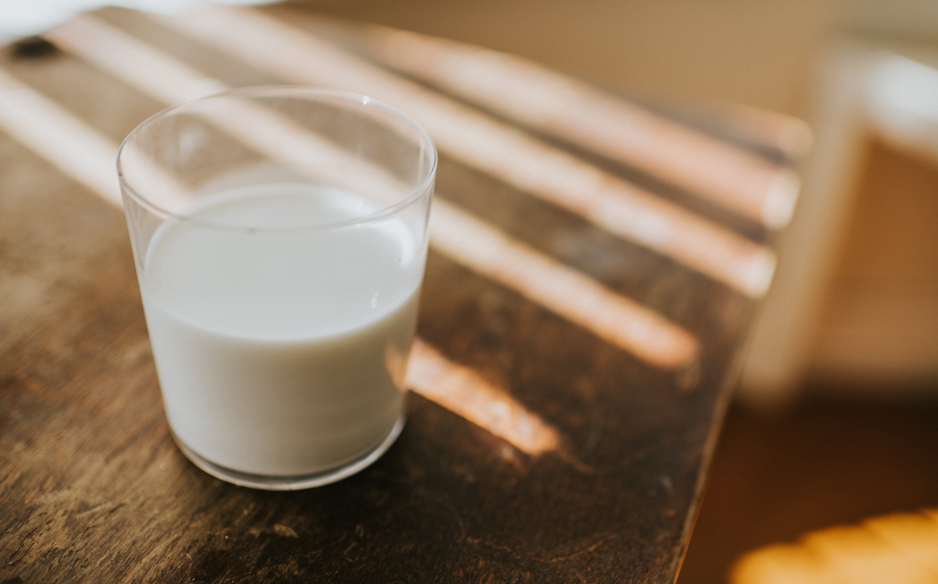
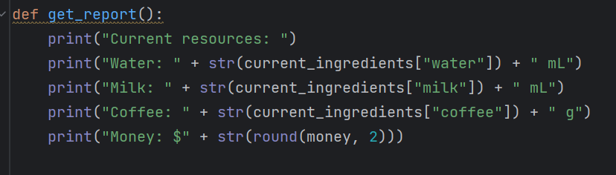

Slide 10
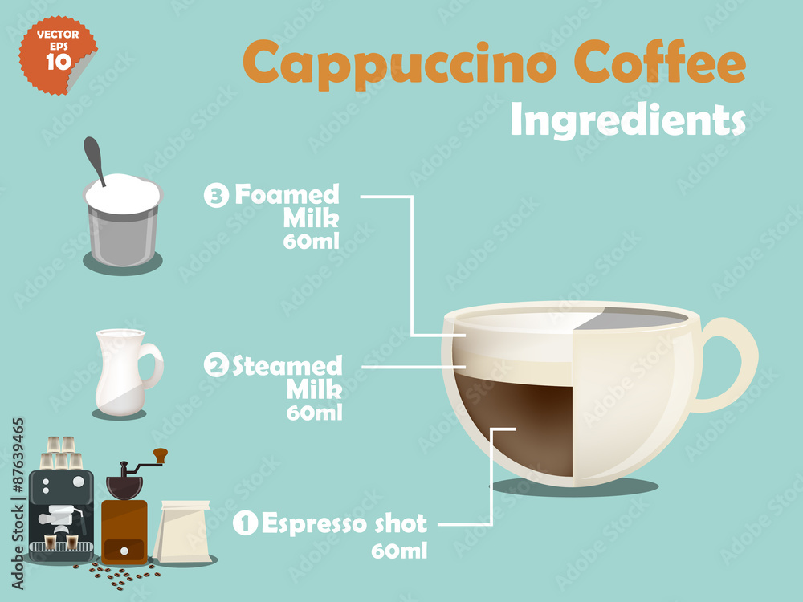
Fourth: Checking if the machine has enough ingredients
Next, we want to make sure that the coffee machine has enough resources to create the ordered drink
We can do this by writing a function that has an input of what drink the user ordered and outputs either True or False depending on if the machine has enough resources
We can then call this function in an elif statement that only allows the user to continue ordering their drink if the machine has enough resources

Slide 11
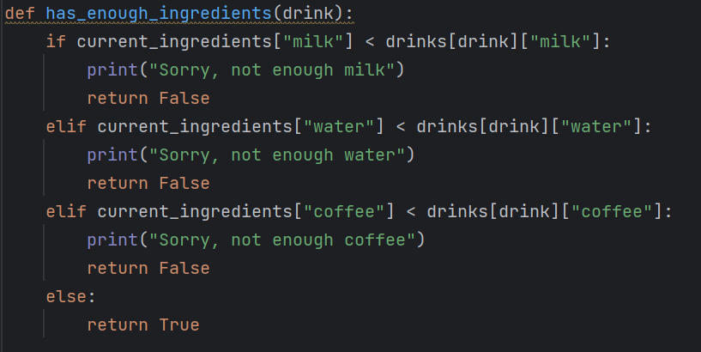
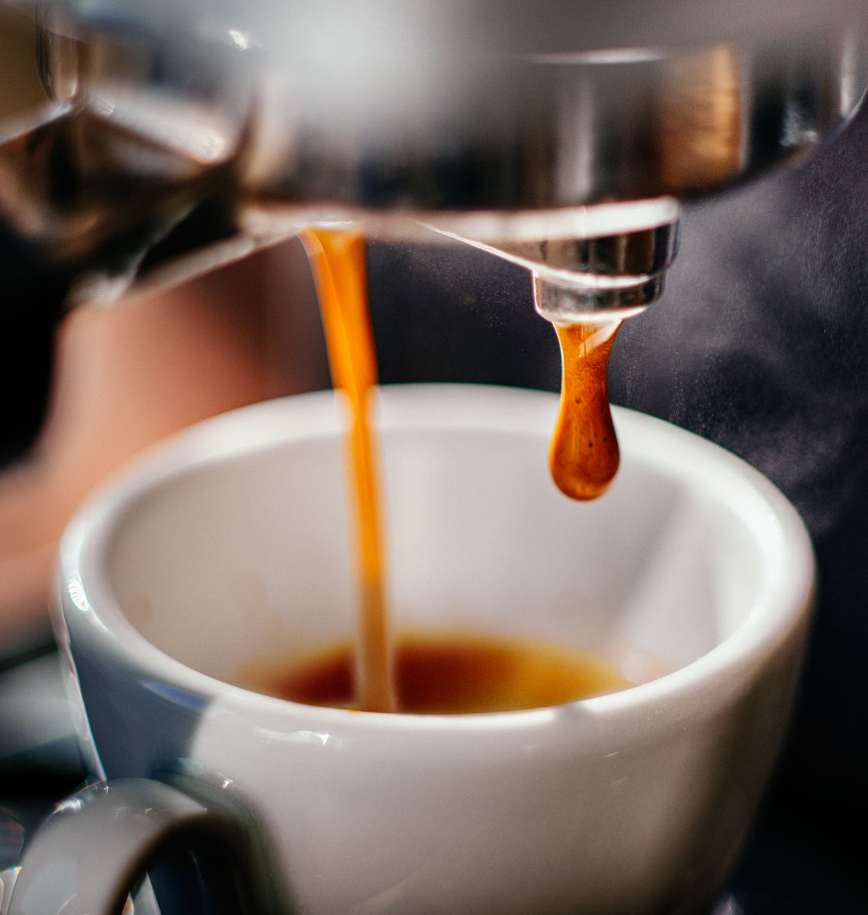
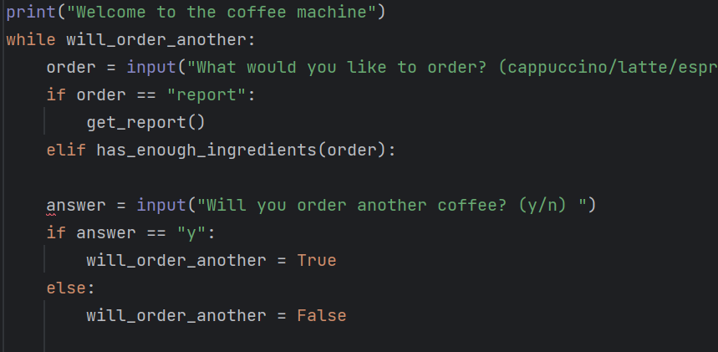

Slide 12
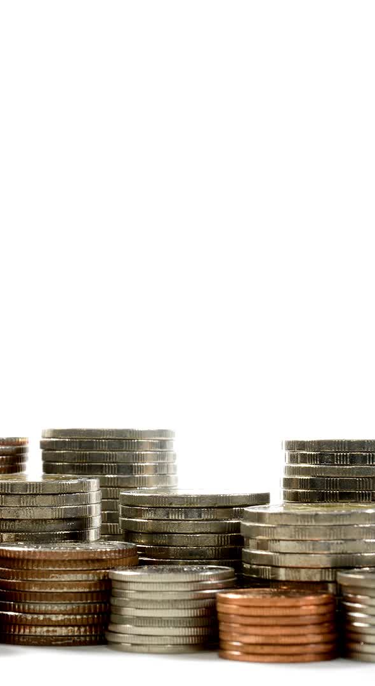
Fifth: Get the user’s money
Next, we must collect the user’s money
To do this, we can create and call a function called get_money() which outputs the amount of money that the user inserted
We can code the get_money() function by asking the user how many pennies, nickels, dimes, and quarters they insert and converting that into dollars

Slide 13
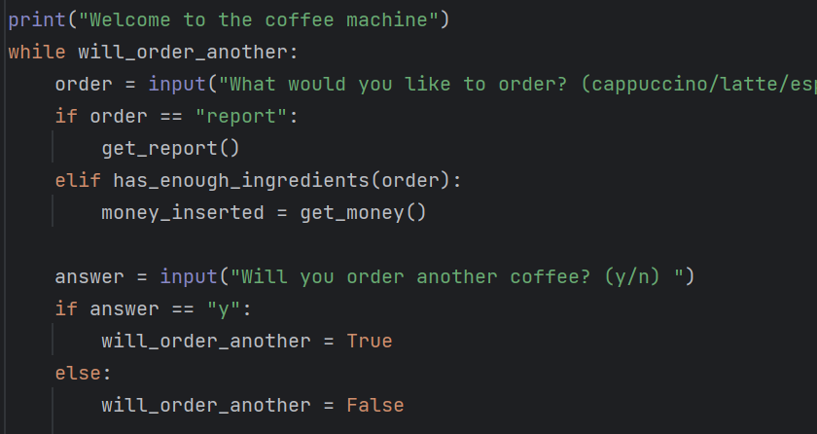
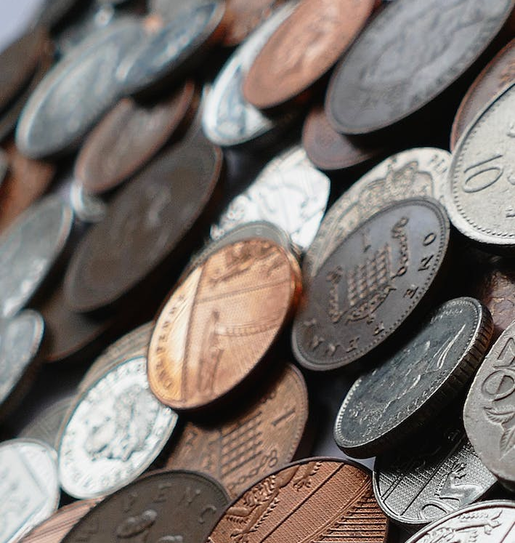
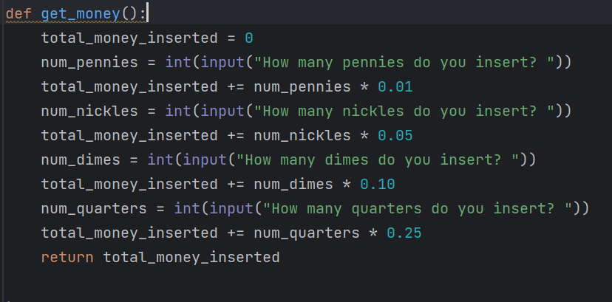

Slide 14
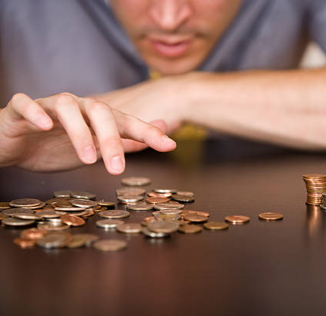
Sixth: Check the user gave enough money
Before we give the user their drink and change, we want to make sure they inserted enough money
We can do this by writing an if statement that prints “Sorry, not enough money. Money refunded” if the user inserted less money than the drink costs

Slide 15
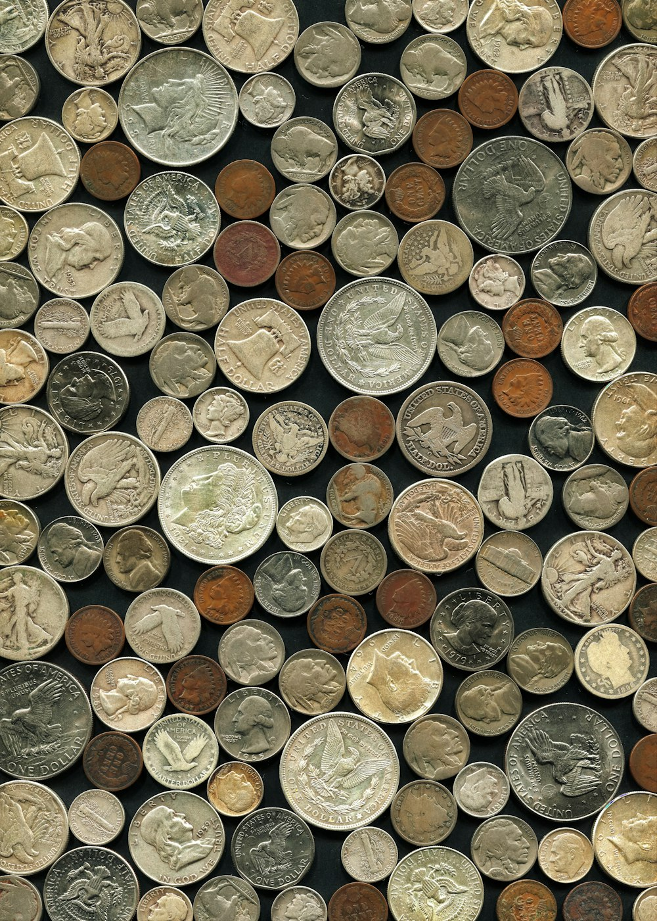
Seventh: Give the user their change
Next, we’ll calculate the user’s change by subtracting the cost of their drink from the amount of money they gave
Then, we’ll print how much change they receive
We will have to use the round() function again to round the money to 2 decimal places

Slide 16
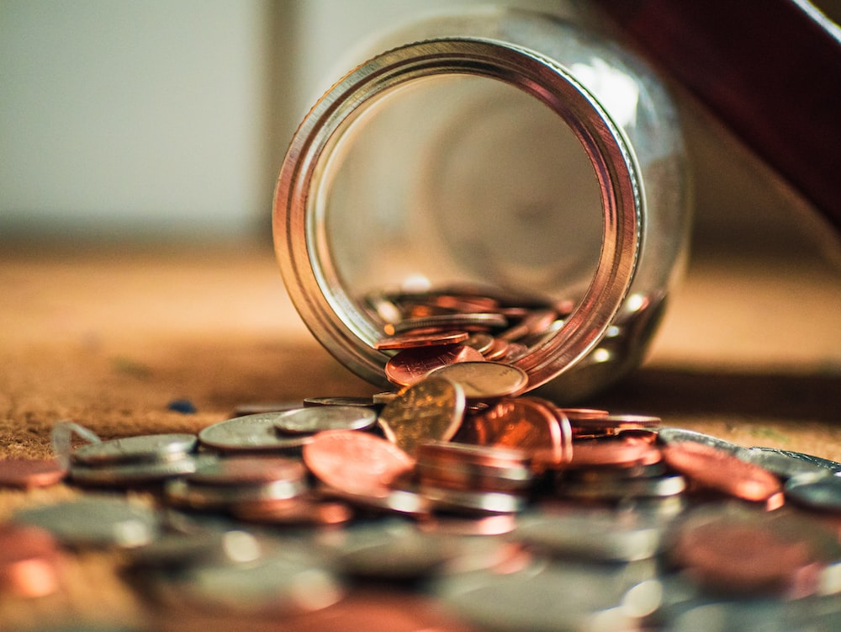
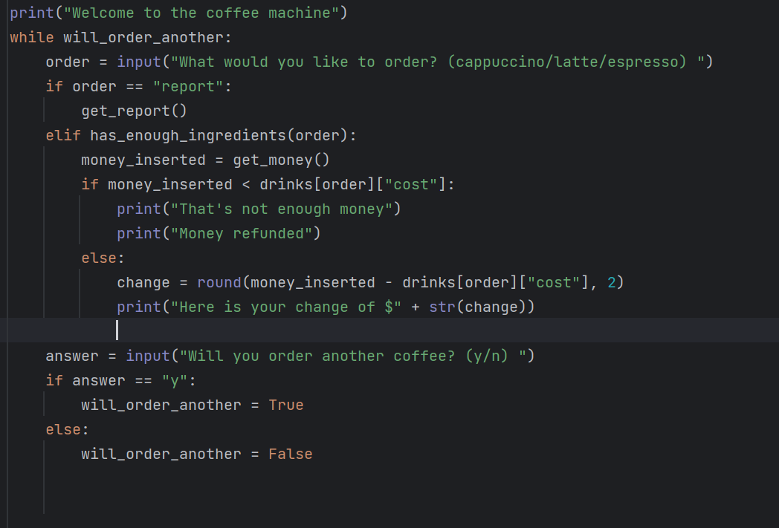

Slide 17

Eighth: Update resources and give the user their coffee
Next, we’ll want to update the coffee machine’s resources and give the user their coffee
We’ll want to:
Add the cost of the drink to the money the machine has
Subtract the drink’s water requirement from the machine’s resources
Subtract the drink’s milk requirement from the machine’s resources
Subtract the drink’s coffee requirement from the machine’s resources
Finally, we can print “Here is your drink ☕”
Get the coffee emoji by searching for “coffee emoji” online and copy + paste it into your code

Slide 18
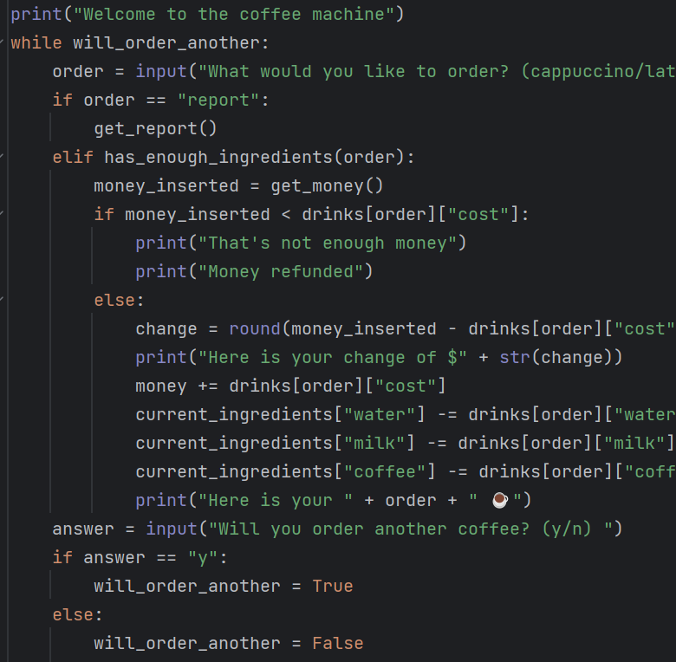
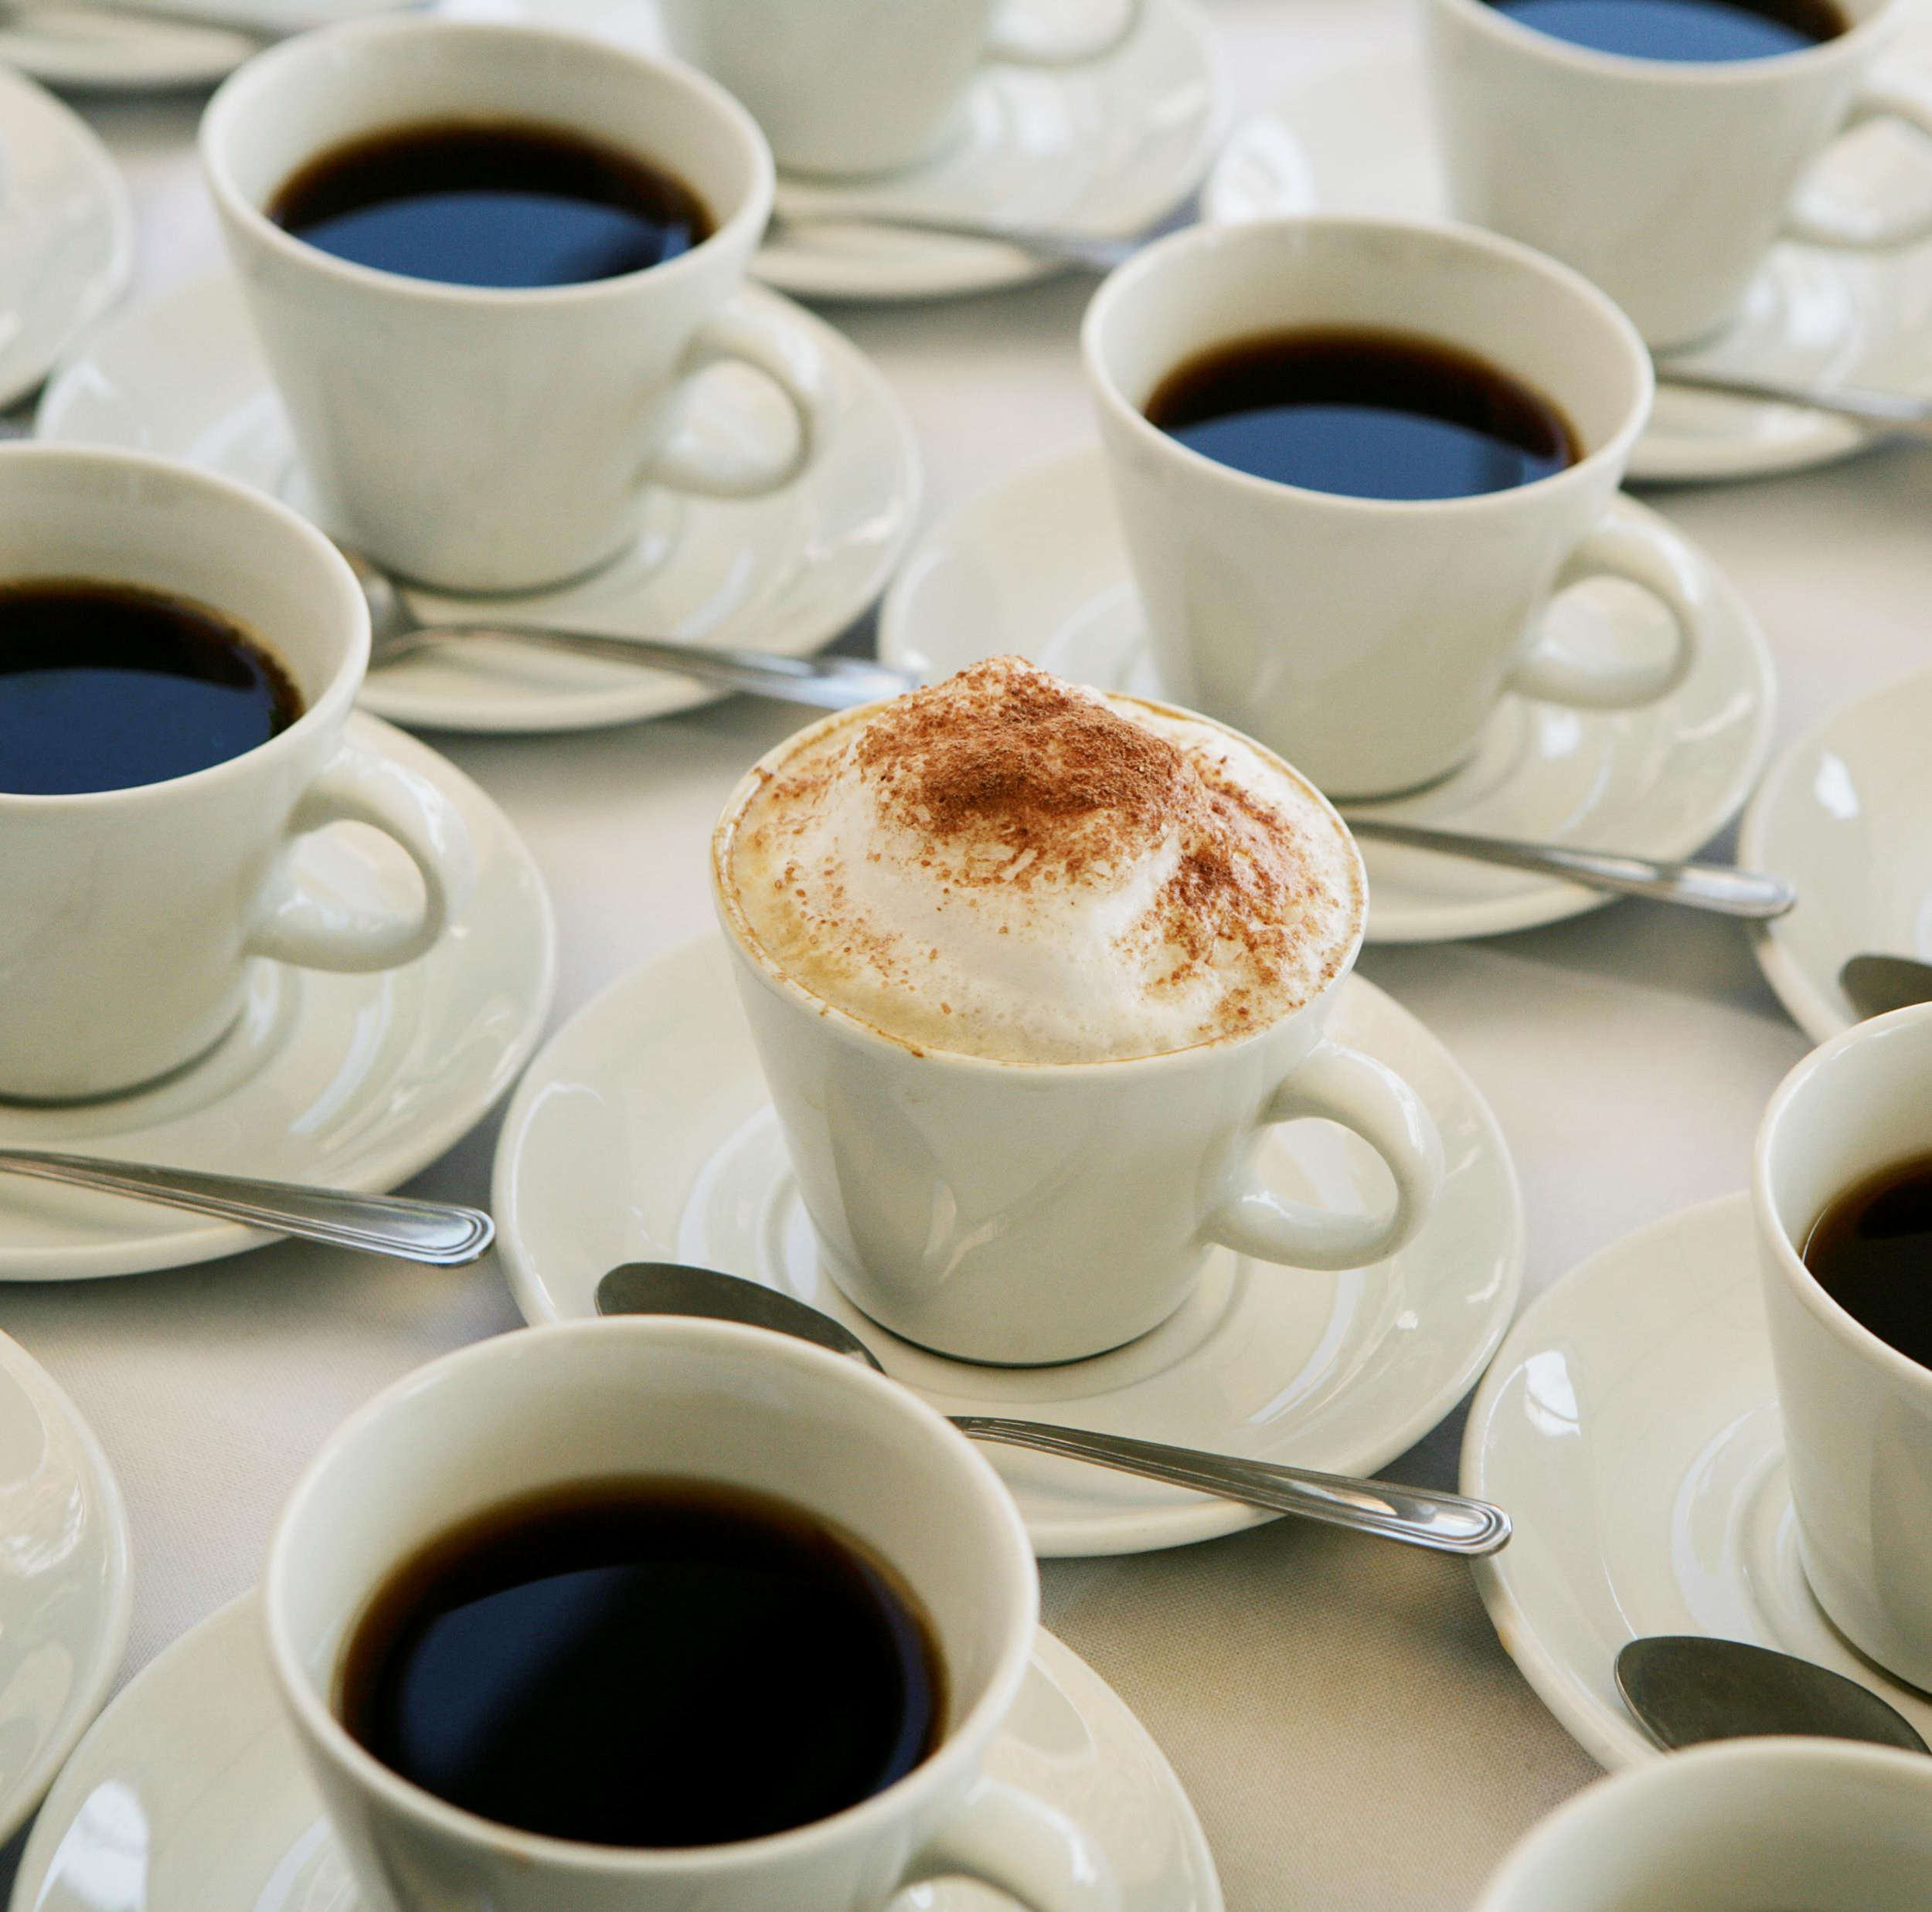

Slide 19
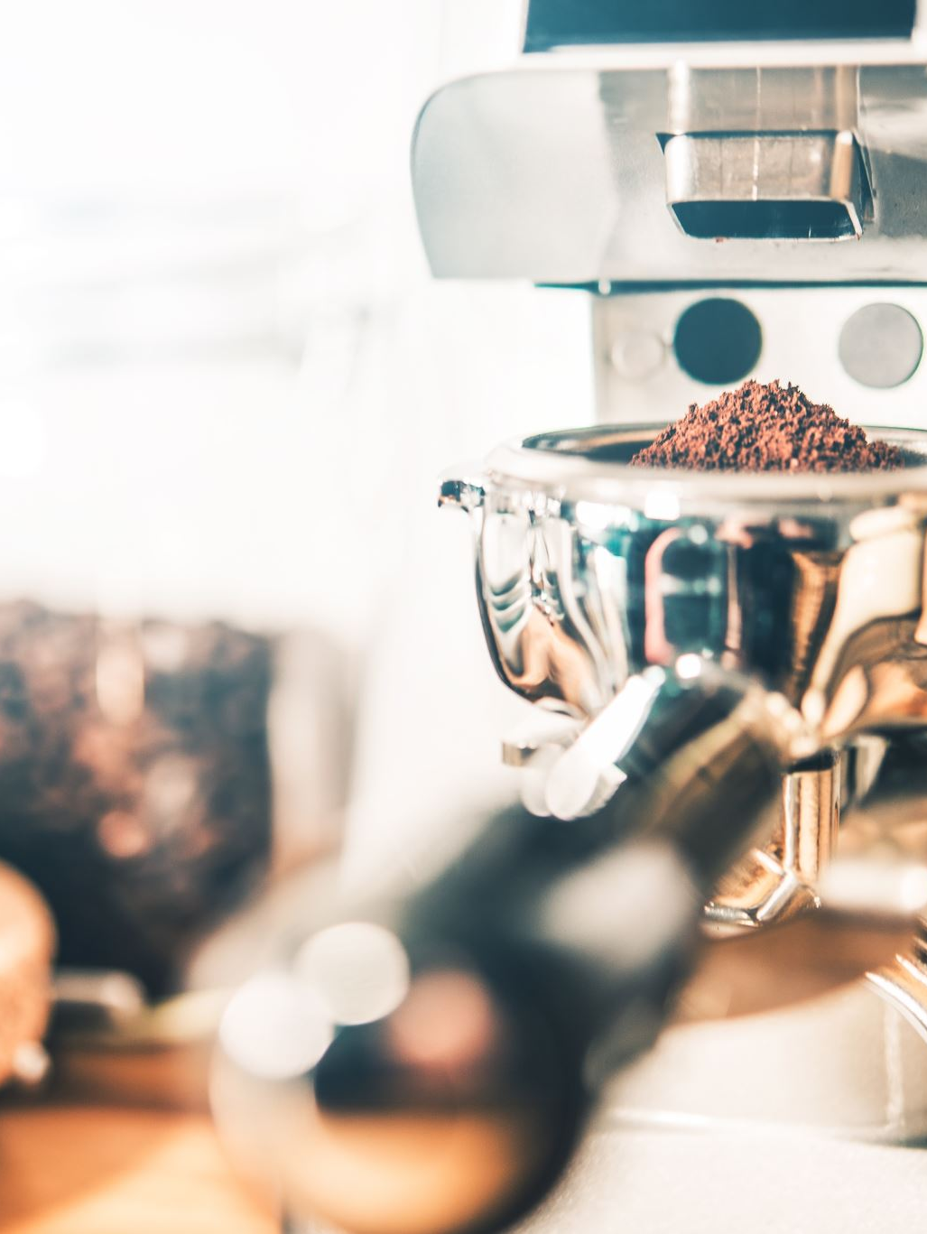
Extras!
To further develop the coffee machine program, you can:
print “Invalid Order” if the user orders something that is not offered by the machine
Print a different emoji depending on the user’s drink
Stop the program if it runs out of enough ingredients to make a drink
Make the program stop if the user types “off.”
Add a refill function that refills the machine’s resources if the user types “refill”

